Slide 1
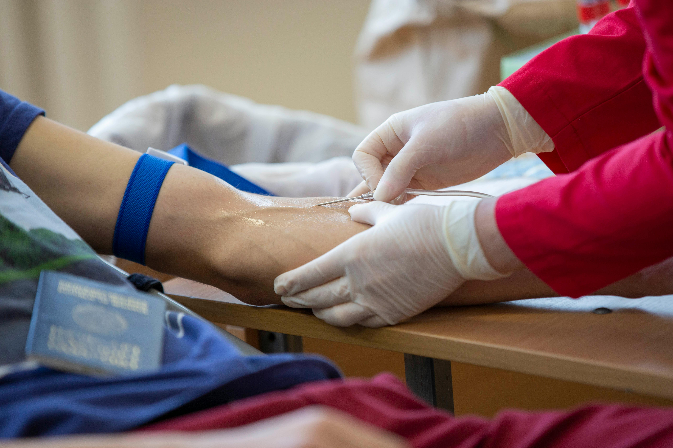
Blood Donation System
By :Team Penstate
Prabesh Khadka
Samichhya Chiluwal
Arpan Adhikari
Nabin Thapa

Slide 2
Introduction
The Blood donation system is a web based application .
In this system, the donor’s information is collected through form where he/she fills up the form.
The receiver request the blood and if blood bank and associated(Red Cross) have requested blood group, the receiver gets blood.
Else, registered donor will be able to donate the requested blood.

Slide 3

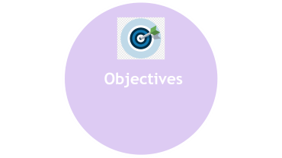
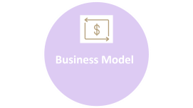
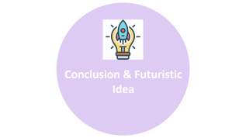
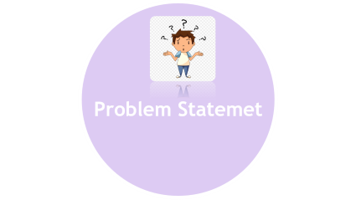


Slide 4

Problem Statemet

Slide 5


Problem Statement
The existing system doesn’t have facility of contacting person to person to fulfil the blood requirements.

Slide 6

Objectives

Slide 7
Objective
To bridge the gap between the blood donor and the blood receiver.

Slide 8

Business Model

Slide 9
Business Model
Viability: Commission by the blood banks, NGOs, CSR funding from different organizations.
Usability: The platform has device compatibility as well as is easy to navigate.
Feasibility:
i. Technical feasibility
ii. Operational feasibility
iii. Legal feasibility

Slide 10
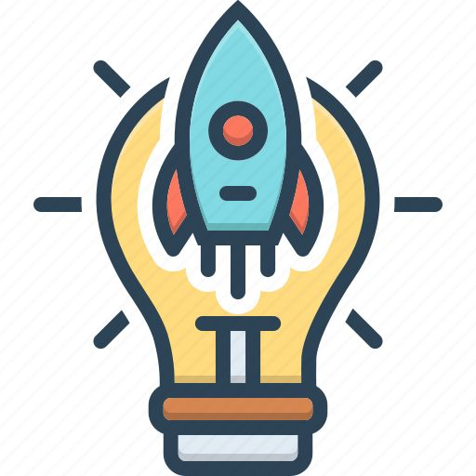
Conclusion & Futuristic Idea

Slide 11
Conclusion & Futuristic Idea
Conclusion:
This platform is poised to make a significant impact in the healthcare sector, contributing to better health outcomes and community welfare.
Futuristic Ideas:
AI-Powered Donation Matching
Global Expansion and Interconnectivity

Slide 12
Reference
[1]
“TopPNG,” TopPNG, Mar. 11, 2019. https://toppng.com/free-image/confused-kid-png-PNG-free-PNG-Images_112399 (accessed Aug. 11, 2024).
‌[2]
“Goal OKR, objective, angle, spiral, logo png | PNGWing,” www.pngwing.com. https://www.pngwing.com/en/free-png-xyplq
‌
[3]
“business model Vector Icons free download in SVG, PNG Format,” Veryicon.com, 2019. https://www.veryicon.com/icons/business/business-plan-icon/business-model.html (accessed Aug. 11, 2024).
[4]
“Conclusion, consideration, great idea, opinion, scheme, thinking, understanding icon - Download on Iconfinder | Blog illustrations, Technology icon, Greatful,” Pinterest, 2024. https://www.pinterest.com/pin/892064638660412237/ (accessed Aug. 11, 2024).

